Slide 1
Stacks and Queues

Slide 2

Stacks
Last-in, First-out data structure
Queues
First-in, First-out data structure
Deque
Double-ended queue
Demo: Contact Manager
Undo
Flight Recorder
Overview

Slide 3
Stack
A Last-in, First-out (LIFO) data container.

Slide 4
The stack of plates is
initially empty
EMPTY

Slide 5
Additional plates can be added to the stack

Slide 6
We can only access the plate at the top of
the stack

Slide 7
The stack of plates is
now 4 deep

Slide 8
There is a top plate and a bottom plate
top
bottom

Slide 9
Plates come off the top of the stack
top
bottom

Slide 10
We “pop” items off
the stack
top
bottom

Slide 11
A single item is the top and bottom
bottom
top

Slide 12
Popping the last item empties the
stack
EMPTY

Slide 13
Queue
A First-in, First-out (FIFO) container.

Slide 14





Slide 15
”Queuing” in a line
Enqueue at end of
line

Slide 16
First is “head”
Last is “tail”
tail
head

Slide 17
The head of the line is
“dequeued”
Next is now “head”
tail
head

Slide 18

A new person waits at the end of the line
tail
head

Slide 19
The queue gets
shorter

Slide 20
The queue gets
shorter

Slide 21
The queue gets
shorter

Slide 22
The queue gets
shorter

Slide 23
Until it is empty

Slide 24
Doubly Ended Queue (deque)
A queue-like container which is both First-in, First-out and Last-in, Last-out.

Slide 25
Doubly Ended Queue
Start with an empty queue
Tail
Head

Slide 26
Doubly Ended Queue
3
Start with an empty queue
Add ”3” to the head
Tail Head

Slide 27
Doubly Ended Queue
2 3
Start with an empty queue
Add ”3” to the head Add “2” to the tail
Tail Head

Slide 28
Doubly Ended Queue
Start with an empty queue
Add ”3” to the head Add “2” to the tail Add ”4” to the head
2 3 4
Tail Head

Slide 29
Doubly Ended Queue
Start with an empty queue
Add ”3” to the head Add “2” to the tail Add ”4” to the head Add “1” to the tail
1 2 3 4
Tail Head

Slide 30
Doubly Ended Queue
Start with an empty queue
Add ”3” to the head Add “2” to the tail Add ”4” to the head Add “1” to the tail Add “5” to the head
1 2 3 4 5
Tail Head

Slide 31
Doubly Ended Queue
1 2 3 4
Remove “5” from the head
Tail Head

Slide 32
Doubly Ended Queue
2 3 4
Remove “5” from the head
Remove “1” from the tail
Tail Head

Slide 33
Doubly Ended Queue
3 4
Remove “5” from the head
Remove “1” from the tail Remove “2” from the tail
Tail Head

Slide 34
Doubly Ended Queue
Remove “5” from the head
Remove “1” from the tail Remove “2” from the tail Remove “4” from the head
3
Tail Head

Slide 35
Doubly Ended Queue
Remove “5” from the head
Remove “1” from the tail Remove “2” from the tail Remove “4” from the head
Remove the “3” from the tail or head
Tail
Head

Slide 36
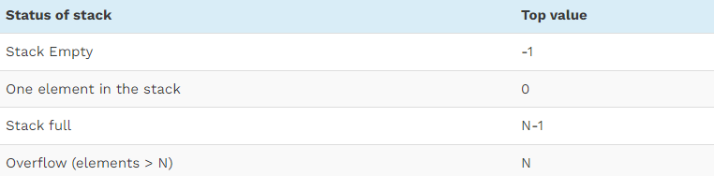

Slide 37
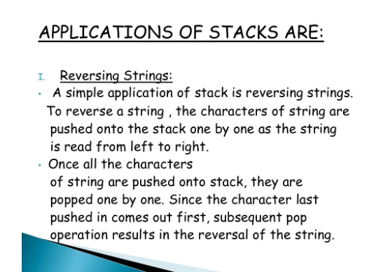

Slide 38
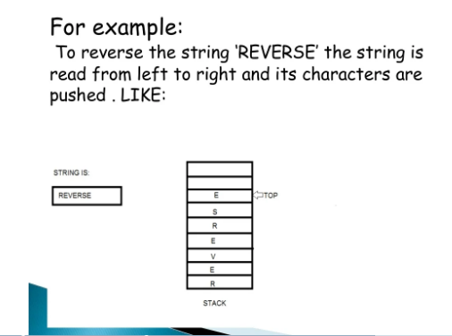

Slide 39
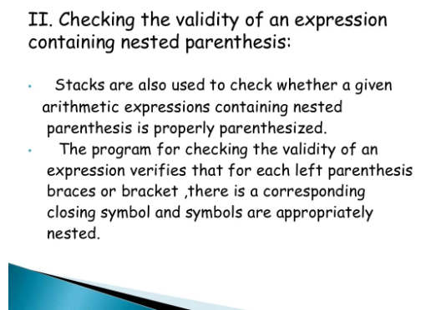

Slide 40
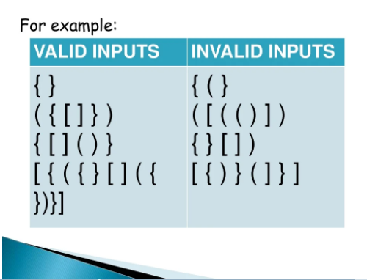

Slide 41
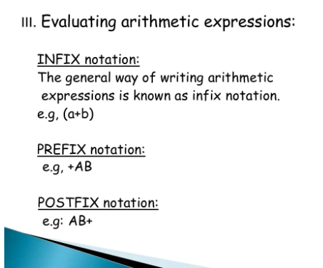

Slide 42
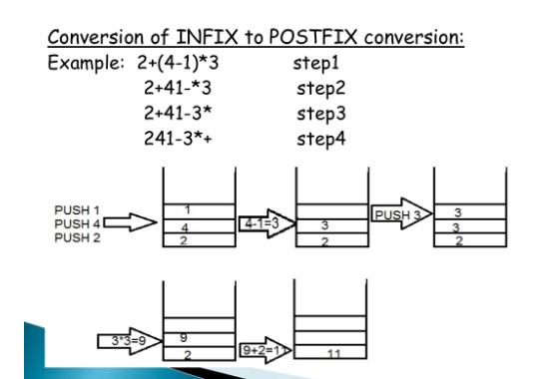

Slide 43
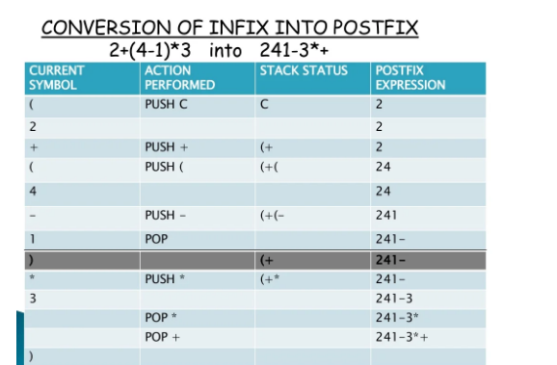

Slide 44

Assisted Practice
Operations performed on a Stack

Slide 45
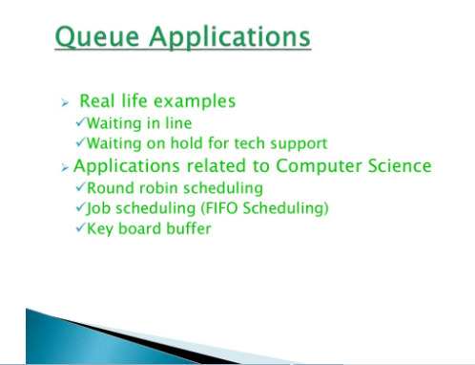

Slide 46
Assisted Practice
Operations performed on a Queue

Slide 47
Assisted Practice
Introduction to the Java ArrayDeque

Slide 48
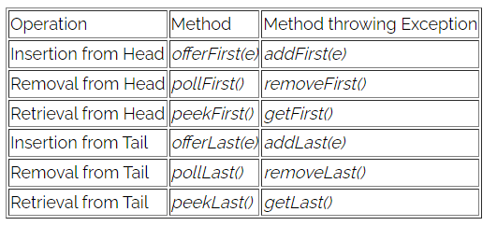
The API at a Glance

Slide 49
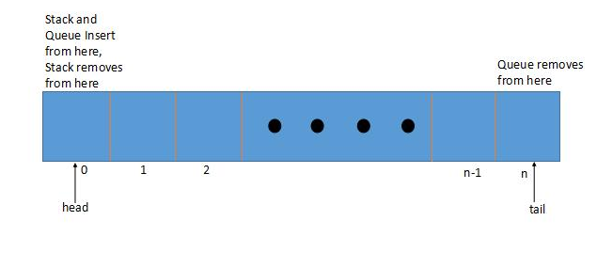
How's ArrayDeque Implemented

Slide 50
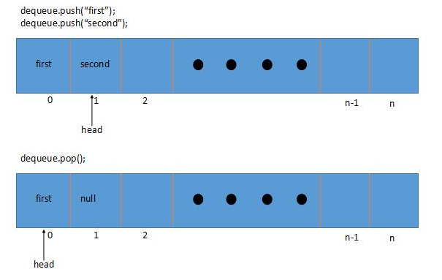
ArrayDeque as Stack

Slide 51
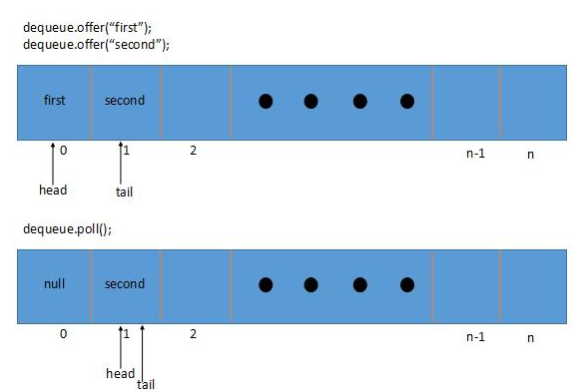
ArrayDeque as a Queue

